Slide 1
Dragons’ Reign
Jordon Kopp
Vince Smeraldo
Derek Finch
Matt Kalafut
Mark Muniz
Josh Kopp

Slide 2
Team Roles
Team Lead
Jordon Kopp
Lead Programmer
Vince Smeraldo
Programmers
Matt Kalafut
Mark Muniz
Derek Finch
Josh Kopp
Designer
Marco Malek
Out sourced artist

Slide 3
Development Environment
Android SDK
Java
Eclipse
Tiled
Tile Engine
TexturePacker
Creates Sprite Sheets
GitHub
Version Control
Online Repository

Slide 4
Game Summary
Backstory
The world is unaware of the presence of dragons within their peaceful societies. Until that fateful day when dragons awakened, the world was never the same.
Story
Dragons have awakened in each of the regions and the local hostile tribes now worship them as Gods. It is the duty of the player to defeat the dragons in each of the regions, shattering the hostile tribes that worship them in the process. This eventually leads to defeating the Elder Dragon to rid the world of dragons forever.

Slide 5
Classes
Warrior
Cleric
Ranger

Slide 6
Attributes
Strength
Increases physical damage
Dexterity
Increases physical damage
Physical critical strike chance
Vitality
Increases base health
Intelligence
Increases spell damage
Spell critical strike chance

Slide 7
Warrior Description
Master of brute force melee combat, capable of frightening the foe with appearance alone. Prefers the simple lifestyle of slaughtering many and enjoying a tall glass of mead on the side.

Slide 8
Warrior Abilities
Basic Attack
No resource
Cleave
Attacks all enemies
75% base damage
Lunge
Single target
Chance to stun
Execute
Full depletion of resource
Damage based on resource depletion
Rend
No initial damage
Chance to bleed
War Cry
Increases party damage
Costs half of total stamina

Slide 9
Warrior Gear
Armor
Heavy
Weapons
One-handed swords
One-handed axes
One-handed maces
Two-handed swords
Two-handed axes
Two-handed maces

Slide 10
Cleric Description
Master of the healing magics, capable of giving the wounded another chance at life. Spends his free time in meditation and prayer in churches and clinics.

Slide 11
Cleric Abilities
Basic Attack
No resource
Heal/Life Syphon
On party pick
Heals 1 party member
On enemy pick
Deals base damage
Half damage dealt converted to health
Revive
Resurrects a fallen party member
Healing Chant
Charges for 1 turn
Heals entire party
Costs substantial mana
Empower
Boost to all primary stats to party
Costs substantial mana
Mend
Heal over time

Slide 12
Cleric Gear
Armor
Light
Weapons
Wands
Orbs
Staves

Slide 13
Ranger Description
Master of ranged attacks, capable of killing with pinpoint precision from afar. Prefers stealing from the rich and giving to the poor.

Slide 14
Ranger Abilities
Basic Attack
No resource
Fire Arrow
Less base damage
Chance to burn
Poison Arrow
Less base damage
Chance to poison
Spread Shot
Attacks all enemies
75% base damage
Charged Shot
Charges for one turn
Chance to deal 2x-5x damage
Stun Arrow
No initial damage
Chance to stun

Slide 15
Ranger Gear
Armor
Medium
Weapons
Longbows
Arrows
Short bows
Arrows
Crossbows
Bolts

Slide 16
Zones
Starter Village
Plains
Mountains

Slide 17
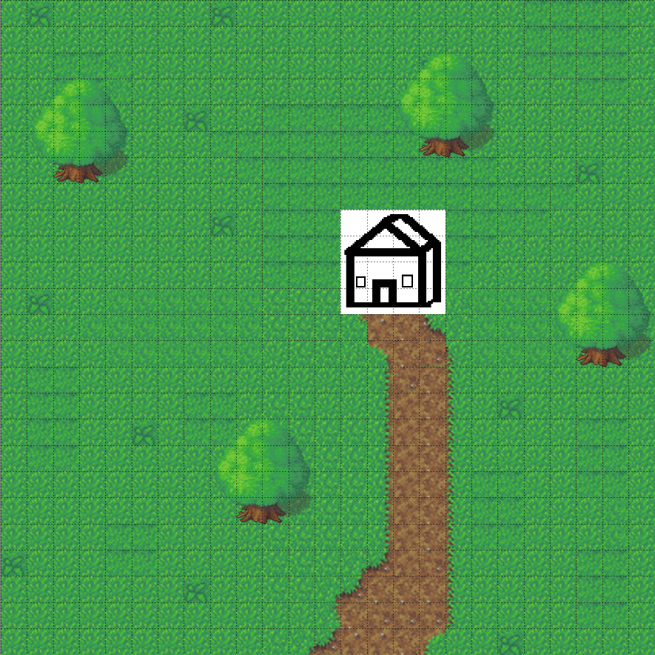
Starter Village

Slide 18

Plains

Slide 19

Mountains

Slide 20
Battle System
Enemies
Wandering
Neutral – engage by choice
Stationary
Harder than random encounters
Better gains
Health/damage modifier
Hostile – line of sight aggro (collision = combat)
Stationary
Same difficulty as mobs in zone
Random
Chance to get into combat whilst walking about the wilds
One enemy can represent one to three enemies

Slide 21
Battle System
Turn order based on internal haste value of the enemy
Each side takes turns
Continues until combat ends
Pop-up occurs at end of combat
Experience
Battle rations
Consumed on pickup
Health/resource gain
Does nothing if player has full health and full resource
Loot and inventory
Drag the desired items from loot box to inventory

Slide 22
Battle System
Battle effects
Blind – chance to miss – 2 turns
Daze – reduced damage – 2 turns
Poison – damage per turn – 2 turns
Burn – damage per turn – 2 turns
Chill – reduces defenses – 2 turns
Stun – blocks all attacks – 1 turn
Bleed – damage per turn – 2 turns

Slide 23
Future
Classes
Assassin
Engineer
Mage
Knight
Zones
Caves
Desert
Tropics
Forest

Slide 24
Future
Fast Travel
Professions/crafting
Ally inventory
Persistent poison damage after battles
Micro-transactions
Currency
Diamonds
Allows instant access to content
Bundles
Remove ads

